Slide 1

OLIST STORE ANALYSIS
Domain : E-Commerce

Slide 2


GROUP 5
Astha Sachan
Vivek Patil
Jithendra Vinayak A. M.
S. Mukesh Kumar

Slide 3
Introduction
Olist is the E-Commerce store from Brazil. The data is provided by Olist itself. The data was given in multiple CSV files. We have treated, removed duplicates and prepared data for analysis. We established the relationship through common columns. We have analyzed this data to visualize it in various modules like Excel, MySQL, Tableau, and PowerBI.

Slide 4

Weekday Vs Weekend (order_purchase_timestamp) Payment Statistics
KPI ONE

Slide 5
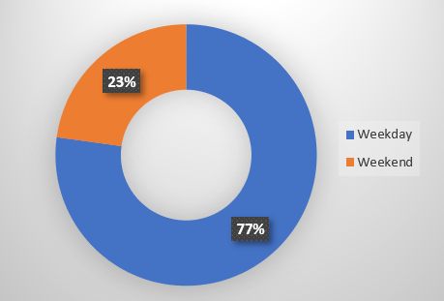
Weekday Vs Weekend (order_purchase_timestamp) Payment Statistics
Payment analysis shows a 77% weekday preference
Sao Paulo leads in both weekday and weekend orders.
Monday tops weekday payments, Sunday for weekends, primarily through credit cards
Strategic marketing initiatives like exclusive weekend offers, promotions, and discounts can help weekend sales
Moreover, analysing weekdays versus weekends enables customer segmentation and personalized marketing, optimizing inventory management for peak shopping periods

Slide 6
Number of Orders with review score 5 and payment type as credit card
KPI TWO

Slide 7
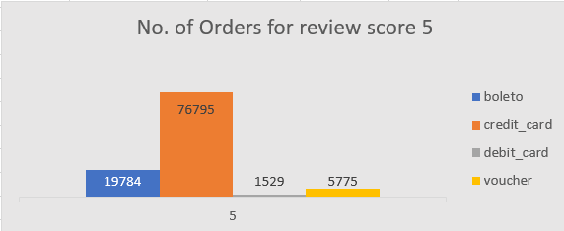
Number of Orders with review score 5 and payment type as credit card
A significant percentage of orders with a review score of 5 are associated with credit card payments, indicating customer satisfaction and trust in the payment method.
This observation aligns with the notion that customers tend to use credit cards for repeat purchases, reflecting loyalty and confidence in the Olist shopping experience.

Slide 8
Average number of days taken for order_delivered_customer_date for pet_shop
KPI THREE

Slide 9
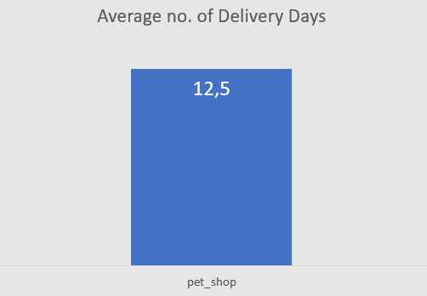
Average number of days taken for order_delivered_customer_date for pet_shop
Avg. Delivery Days for Pet Shop Orders=12.5
Impacts customer satisfaction and loyalty
Highlights areas for operational efficiency improvement
Optimize logistics and supply chain management
Improve delivery efficiency through partnerships or in-house capabilities
Implement tracking and inventory management systems

Slide 10
Average price and payment values from customers of sao paulo city
KPI FOUR

Slide 11
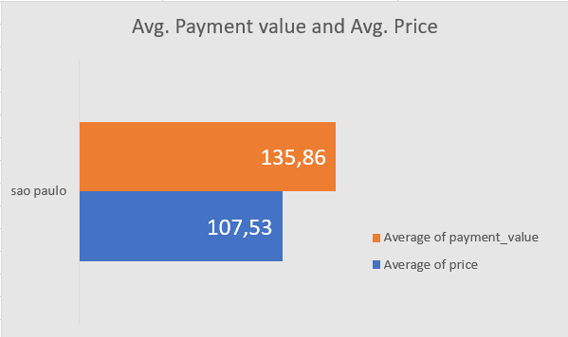
Average Price and Payment values from customers of sao paulo city
Avg. Price for all Cities= 154.10
Avg. Payment values all Cities = 120.65
Avg. Price (Sao Paulo) = 135.86
Avg. Payment values (Sao Paulo)= 107.53
Payment type used maximum in Sao Paulo is Credit card = 12226 times

Slide 12
Relationship between shipping days (order_delivered_customer_date - order_purchase_timestamp) Vs review scores
KPI FIVE

Slide 13
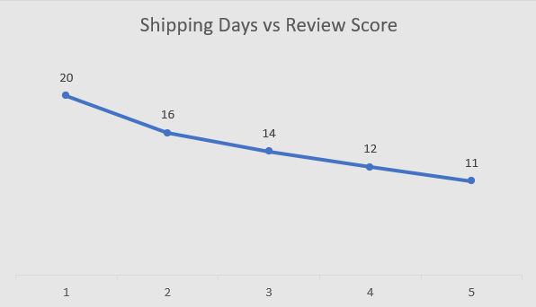
Relationship between shipping days (order_delivered_customer_date - order_purchase_timestamp) Vs review score
Review Scores are 1 to 5
Avg. Shipping days = 12.5
More shipping days = Bad Review Score
Needs to improve shipping days
Better review leads to repeat customers

Slide 14
Summary
KPI 1
Weekdays has better payment stats than that of Weekends
KPI 2
Credit card is the most used payment type for review score 5
KPI 3
Delivery days must be reduced to improve customer satisfaction
KPI 4
Avg. Price and Avg. Payment value for Sao Paulo is less than Avg. of all cities
KPI 5
Review scores are inversely proportional to the no. of Shipping days.

Slide 15
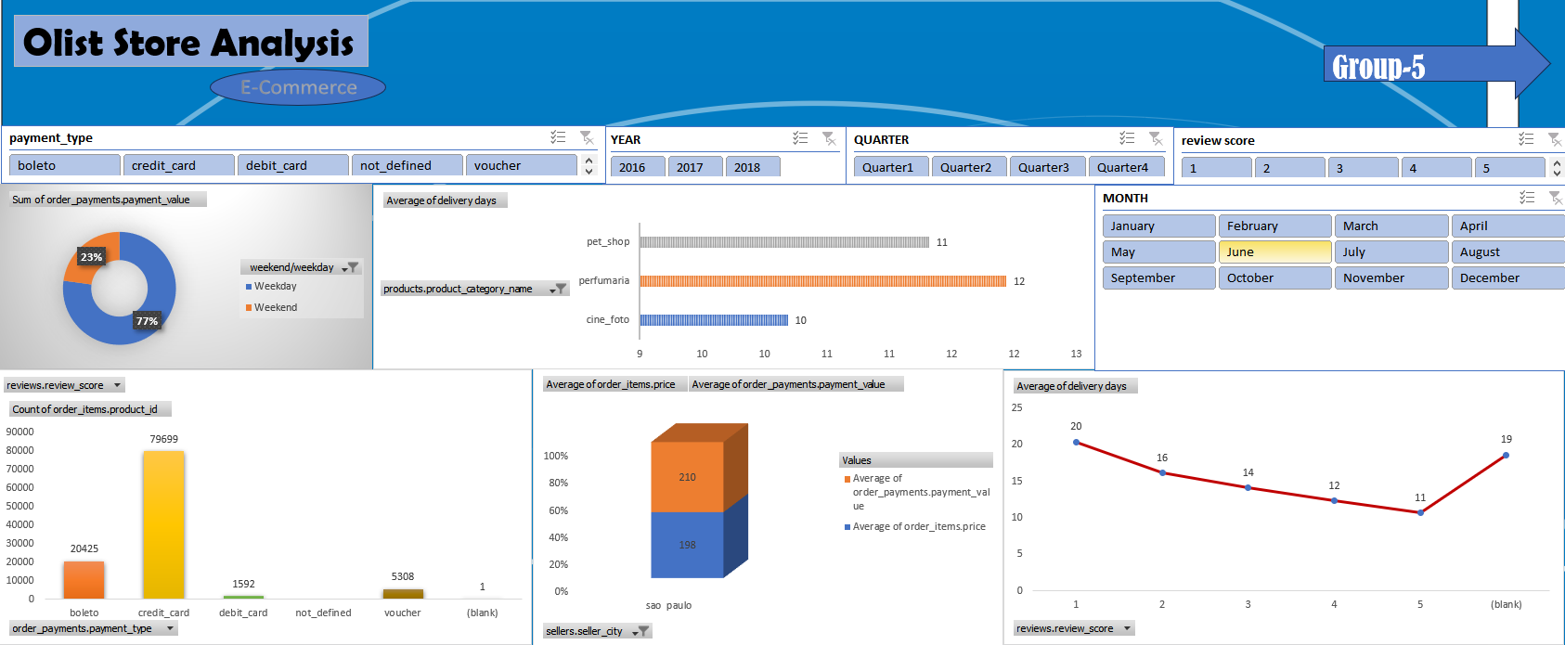
Excel Dashboard

Slide 16
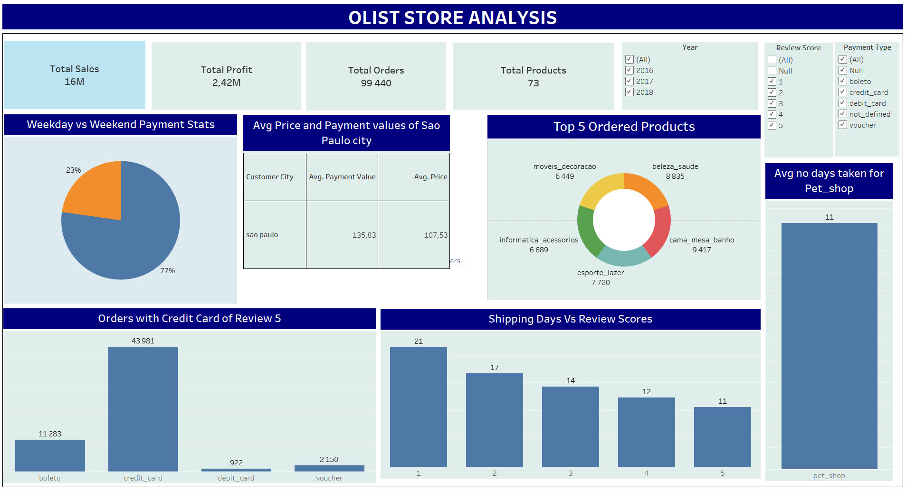
Tableau Dashboard

Slide 17
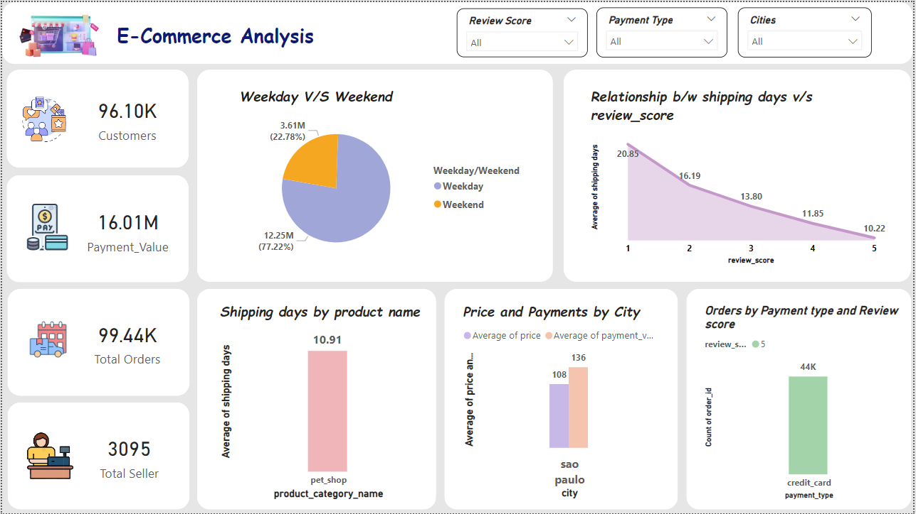
PowerBI Dashboard

Slide 18

THANK YOU
Group 5

